Slide 1
ECE408 Fall 2016 Applied Parallel Programming Lecture 17: Atomic Operations and Histogramming - Part 2

Slide 2
Objective
To learn practical histogram programming techniques
Basic histogram algorithm using atomic operations
Atomic operation throughput
Privatization

Slide 3
Review: A Histogram Example
In phrase “Programming Massively Parallel Processors” build a histogram of frequencies of each letter
A(4), C(1), E(1), G(1), …
How do you do this in parallel?
Have each thread to take a section of the input
For each input letter, use atomic operations to build the histogram

Slide 4
Iteration #1 – 1st letter in each section
P
R
O
G
R
A
M
M
I
N
G
M
A
S
S
I
V
E
L
Y
P
Thread 0
Thread 1
Thread 2
Thread 3
1
2
1
A
B
C
D
E
F
G
H
I
J
K
L
M
N
O
P
Q
R
S
T
U
V

Slide 5
Iteration #2 – 2nd letter in each section
P
R
O
G
R
A
M
M
I
N
G
M
A
S
S
I
V
E
L
Y
P
Thread 0
Thread 1
Thread 2
Thread 3
1
1
1
3
1
1
A
B
C
D
E
F
G
H
I
J
K
L
M
N
O
P
Q
R
S
T
U
V

Slide 6
Iteration #3
P
R
O
G
R
A
M
M
I
N
G
M
A
S
S
I
V
E
L
Y
P
Thread 0
Thread 1
Thread 2
Thread 3
1
1
1
1
3
1
1
1
1
A
B
C
D
E
F
G
H
I
J
K
L
M
N
O
P
Q
R
S
T
U
V

Slide 7
Iteration #4
P
R
O
G
R
A
M
M
I
N
G
M
A
S
S
I
V
E
L
Y
P
Thread 0
Thread 1
Thread 2
Thread 3
1
1
1
1
1
3
1
1
1
1
2
A
B
C
D
E
F
G
H
I
J
K
L
M
N
O
P
Q
R
S
T
U
V

Slide 8
Iteration #5
P
R
O
G
R
A
M
M
I
N
G
M
A
S
S
I
V
E
L
Y
P
Thread 0
Thread 1
Thread 2
Thread 3
1
1
1
1
1
3
1
1
2
2
2
A
B
C
D
E
F
G
H
I
J
K
L
M
N
O
P
Q
R
S
T
U
V

Slide 9
What is wrong with the algorithm?

Slide 10
What is wrong with the algorithm?
Reads from the input array are not coalesced
Assign inputs to each thread in a strided pattern
Adjacent threads process adjacent input letters
P
R
O
G
R
A
M
M
I
N
G
M
A
S
S
I
V
E
L
Y
P
Thread 0
Thread 1
Thread 2
Thread 3
1
1
1
1
A
B
C
D
E
F
G
H
I
J
K
L
M
N
O
P
Q
R
S
T
U
V

Slide 11
Iteration 2
All threads move to the next section of input
P
R
O
G
R
A
M
M
I
N
G
M
A
S
S
I
V
E
L
Y
P
Thread 0
Thread 1
Thread 2
Thread 3
1
1
2
1
1
2
A
B
C
D
E
F
G
H
I
J
K
L
M
N
O
P
Q
R
S
T
U
V

Slide 12
A Histogram Kernel
The kernel receives a pointer to the input buffer
Each thread process the input in a strided pattern
__global__ void histo_kernel(unsigned char *buffer,
long size, unsigned int *histo)
{
int i = threadIdx.x + blockIdx.x * blockDim.x;
// stride is total number of threads
int stride = blockDim.x * gridDim.x;

Slide 13
More on the Histogram Kernel
// All threads handle blockDim.x * gridDim.x
// consecutive elements
while (i < size) {
atomicAdd( &(histo[buffer[i]]), 1);
i += stride;
}
}

Slide 14
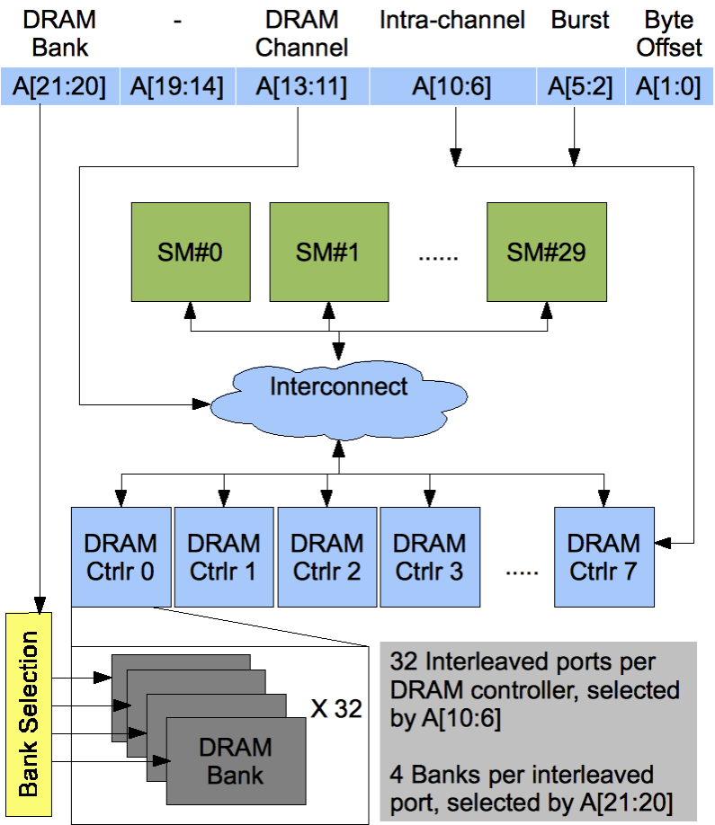
Atomic Operations on DRAM
An atomic operation starts with a read, with a latency of a few hundred cycles

Slide 15
Atomic Operations on DRAM
An atomic operation starts with a read, with a latency of a few hundred cycles
The atomic operation ends with a write, with a latency of a few hundred cycles
During this whole time, no one else can access the location

Slide 16
Atomic Operations on DRAM
Each Load-Modify-Store has two full memory access delays
All atomic operations on the same variable (RAM location) are serialized
time
internal routing
internal routing
DRAM delay
DRAM delay
DRAM delay
..
transfer delay
transfer delay
atomic operation N
atomic operation N+1

Slide 17
Latency determines throughput of atomic operations
Throughput of an atomic operation is the rate at which the application can execute an atomic operation on a particular location.
The rate is limited by the total latency of the read-modify-write sequence, typically more than 1000 cycles for global memory (DRAM) locations.
This means that if many threads attempt to do atomic operation on the same location (contention), the memory bandwidth is reduced to < 1/1000!

Slide 18
You may have a similar experience in supermarket checkout
Some customers realize that they missed an item after they started to check out
They run to the isle and get the item while the line waits
The rate of check is reduced due to the long latency of running to the isle and back.
Imagine a store where every customer starts the check out before they even fetch any of the items
The rate of the checkout will be 1 / (entire shopping time of each customer)

Slide 19
Hardware Improvements (cont.)
Atomic operations on Fermi L2 cache
medium latency, but still serialized
Global to all blocks
“Free improvement” on Global Memory atomics
time
internal routing
..
data transfer
data transfer
atomic operation N
atomic operation N+1

Slide 20
Hardware Improvements
Atomic operations on Shared Memory
Very short latency, but still serialized
Private to each thread block
Need algorithm work by programmers (more later)
time
internal routing
..
data transfer
atomic operation N
atomic operation N+1

Slide 21
Atomics in Shared Memory Requires Privatization
Create private copies of the histo[] array for each thread block
__global__ void histo_kernel(unsigned char *buffer,
long size, unsigned int *histo)
{
__shared__ unsigned int histo_private[256];
if (threadIdx.x < 256) histo_private[threadidx.x] = 0;
__syncthreads();

Slide 22
Build Private Histogram
int i = threadIdx.x + blockIdx.x * blockDim.x;
// stride is total number of threads
int stride = blockDim.x * gridDim.x;
while (i < size) {
atomicAdd( &(private_histo[buffer[i]), 1);
i += stride;
}

Slide 23
Build Final Histogram
// wait for all other threads in the block to finish
__syncthreads();
if (threadIdx.x < 256)
atomicAdd( &(histo[threadIdx.x]), private_histo[threadIdx.x] );
}

Slide 24
More on Privatization
Privatization is a powerful and frequently used techniques for parallelizing applications
The operation needs to be associative and commutative
Histogram add operation is associative and commutative
The histogram size needs to be small
Fits into shared memory
What if the histogram is too large to privatize?

Slide 25
ANY MORE QUESTIONS? READ CHAPTER 8

